Slide 1
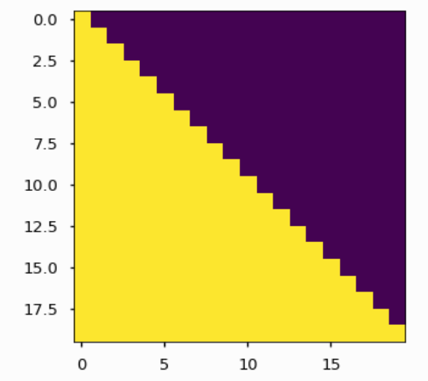
Attention Mask

Slide 2

Positional Encoding
For any fixed offset k,
PE(pos+k) can be represented as a linear function of PEpos.

Slide 3
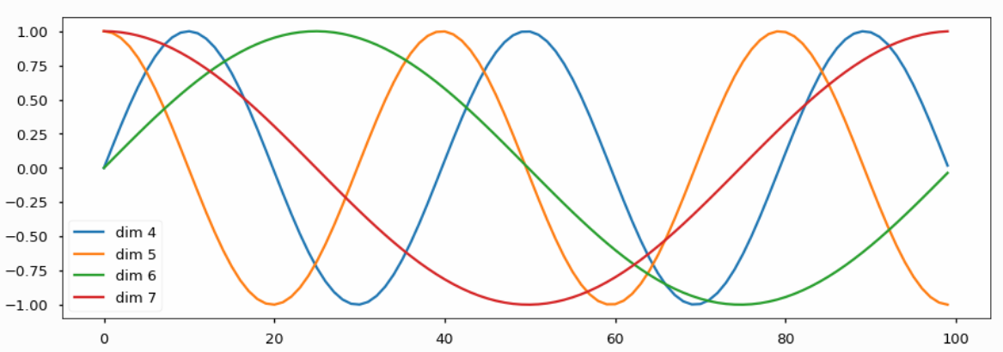
Positional Encoding

Slide 4
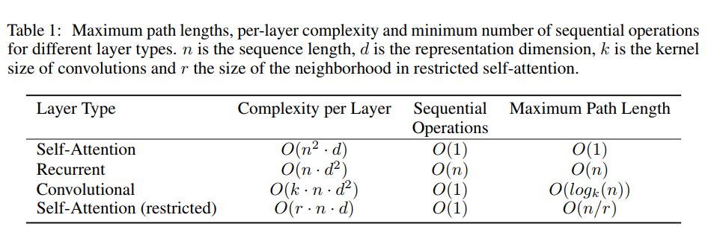
Why Self-Attention?

Slide 5
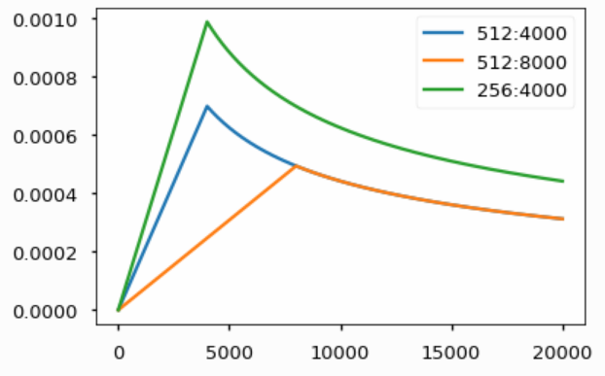
Optimizer

Slide 6
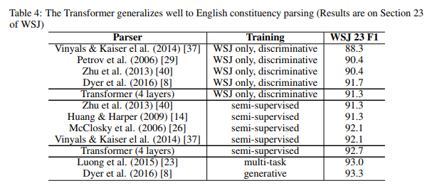
Constituency Parser

Slide 7
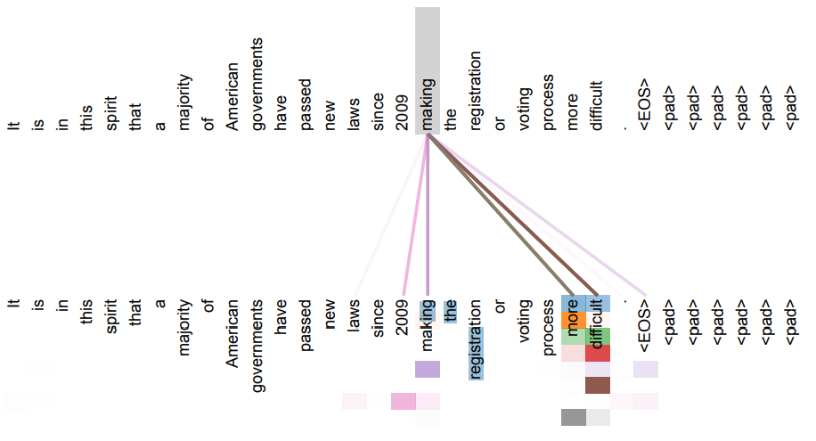
Attention Visualization

Slide 8
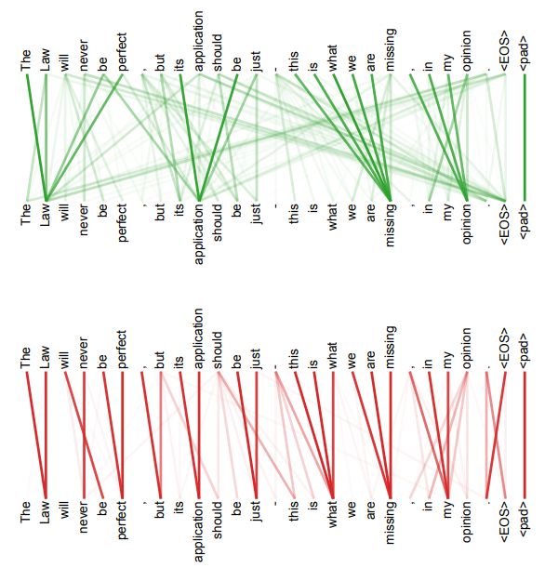
Attention Visualization

